Slide 1

BANGALORE INSTITUTE OF TECHNOLOGY
INFORMATION SCIENCE AND ENGINEERING
ACCIDENT ALERT SYSTEM
PROJECT DONE BY
SHREYAS P
ABRAR MOHAMMED
SUPRIT BABU
V VARUN REDDY
UNDER THE GUIDANCE OF
M.SHILPA

Slide 2
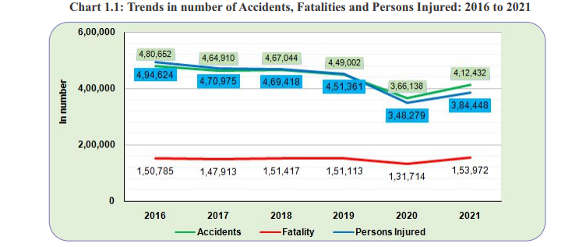
INTRODUCTION
The usage of vehicles is growing at a fastest rate as the population increases. Accidents and the death rate are highly increased due to the irregular management of traffic. Mostly, deaths due to accidents are happened due to the time lagging of medical assistance. Majorly it was happened in highways to rectify this problem we have proposed this device.
This action is done by sending a reliable data of an accident to the hospital and medical assistance for immediate recovery. The time efficiency of this system has faster than the before cases.

Slide 3




The requirements of the project
MICROCONTROLLER
BLUETOOTH MODULE
ACCIDENT ALERT APP
MEMS SENSOR

Slide 4
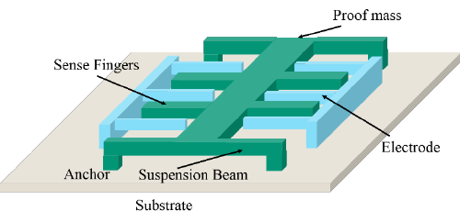
MEMS SENSOR
MEMS sensor stands for Microelectromechanical Systems. MEMS sensors are small-scale devices that integrate both mechanical and electrical components on a single chip. MEMS sensor has an in-built accelerometer, gyroscope, thermometer etc. These sensors are designed to sense and measure various physical parameters such as motion, pressure, temperature, humidity, and more.
The accelerometer measures the vibration or acceleration of motion of a structure. Capacitive accelerometer sensors work by changing their capacitance based on the acceleration they experience. Their construction involves two capacitive plates and a diaphragm

Slide 5
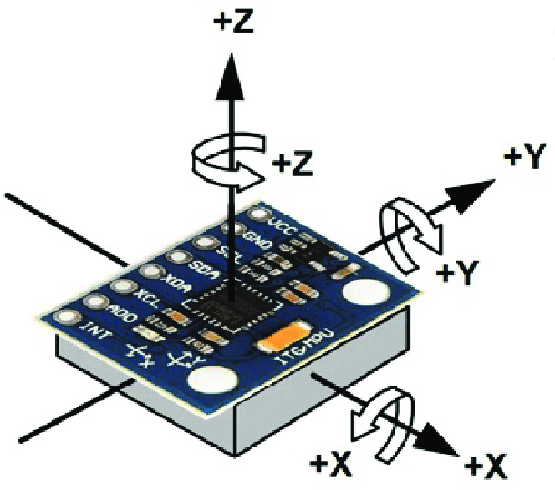
As the sensor experiences acceleration, the diaphragm moves and changes the distance between the capacitive plates. This results in the capacitance of the sensor to change, and this change in capacitance can be measured and translated to the rate of acceleration on the sensor.
A gyroscope sensor is a device that is used to measure and maintain the orientation and angular velocity of an object. This sensor is also known by various names such as Angular Rate Sensor or Angular Velocity Sensors. By this, we can detect the orientation of the car

Slide 6
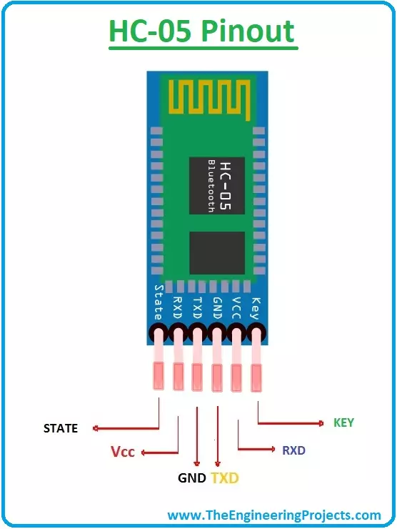
The communication between the device and mobile
The HC-05 is a Bluetooth module that connects to the serial port of a microcontroller, which allows the microcontroller to communicate with other devices over a Bluetooth connection

Slide 7



The features of Accident Alert App
01
02
03
GPS
SMS
BLUETOOTH
Tracks the current location
Sends the information to the emergency services
Connects with the microcontroller

Slide 8
WORKFLOW
THE PERSON IS CONSCIOUS
When a car met with an accident, the MEMS sensor detects the accident and sends the signal to the microcontroller
stops the further process
THE PERSON IS UNCONSCIOUS
The microcontroller sends a signal to the mobile app running in the background.
The app accesses the GPS location of the vehicle and sends a message to the nearest emergency services and family members.

Slide 9
THANK
YOU
Life don’t have RESET button. Drive safe

